Slide 1


The Place
LWTS Technologies
JunctionXBudapest, 2019

Slide 2
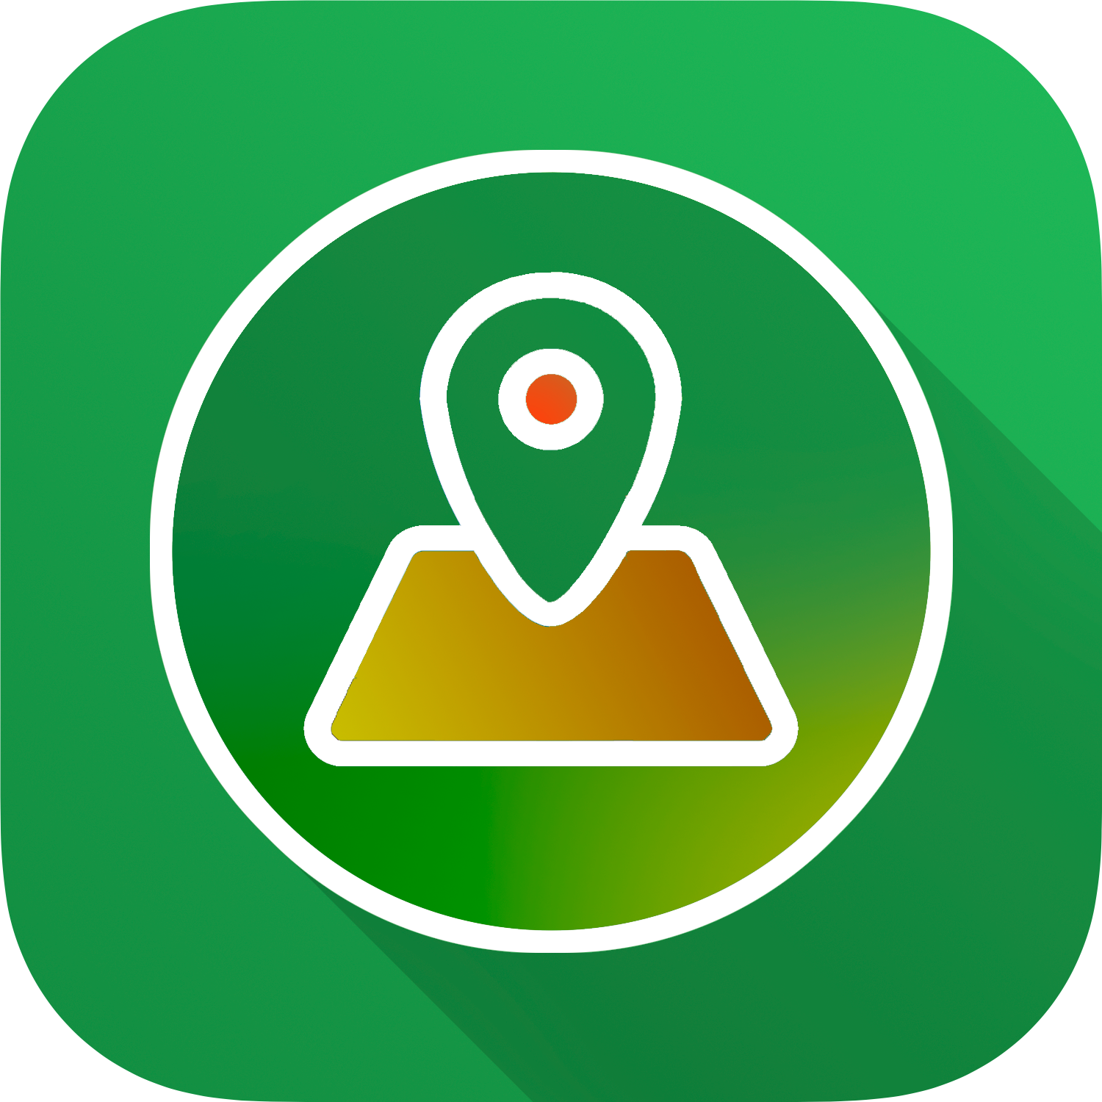
What have we created?
«The place» is a tool to animals and humans to prevent and reduce the disruptions caused by and to human-built structures.

Slide 3

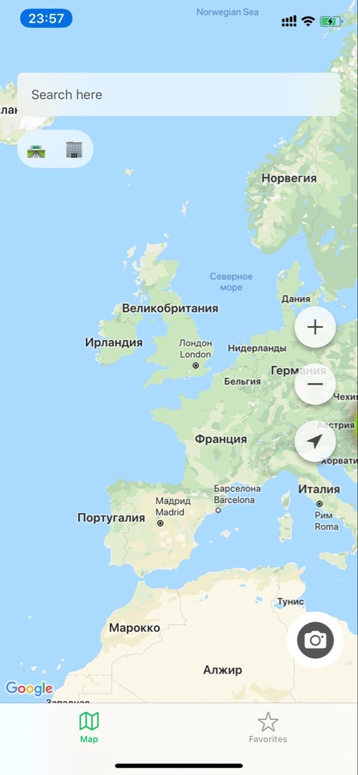

Using our app
Enter address
Chose building style, features and facilities
See the animal movement pattern and restrictions due to this
Get some recommendations

Slide 4
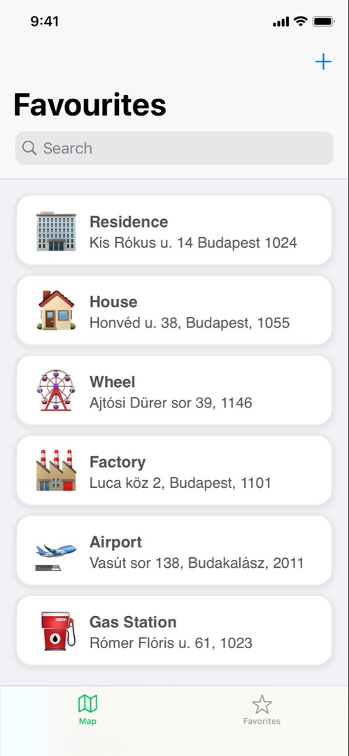
Using our app
Enter address
Chose building style, features and facilities
See the animal movement pattern and restrictions due to this
Get some recommendations

Slide 5
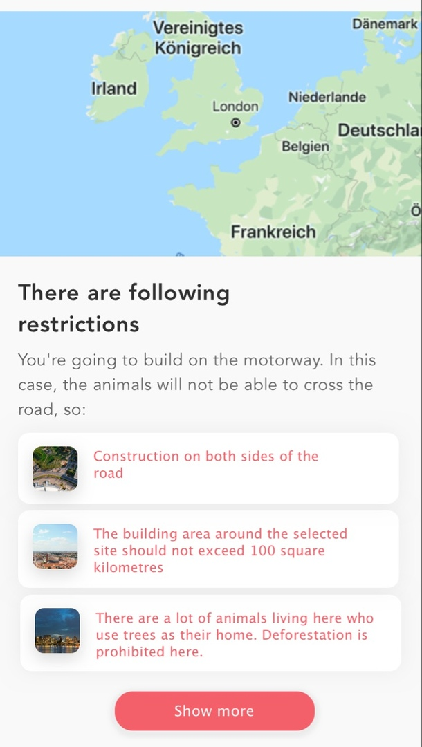
Using our app
Enter address
Chose building style, features and facilities
See the animal movement pattern and restrictions due to this
Get some recommendations

Slide 6
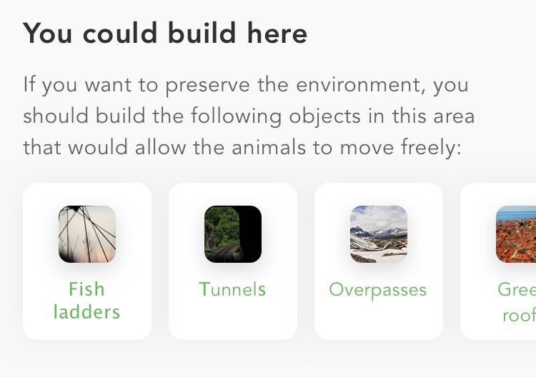
Using our app
Enter address
Chose building style, features and facilities
See the animal movement pattern and restrictions due to this
Get some recommendations

Slide 7
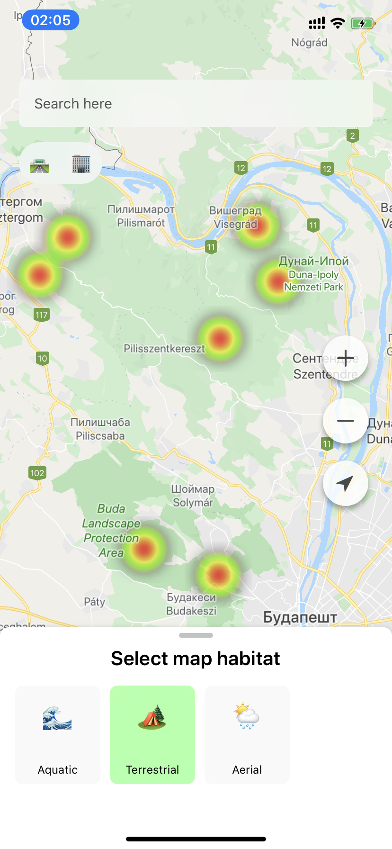
How does it work?
PoC and MVP application
Heat map
Cluster analysis
Computer vision

Slide 8
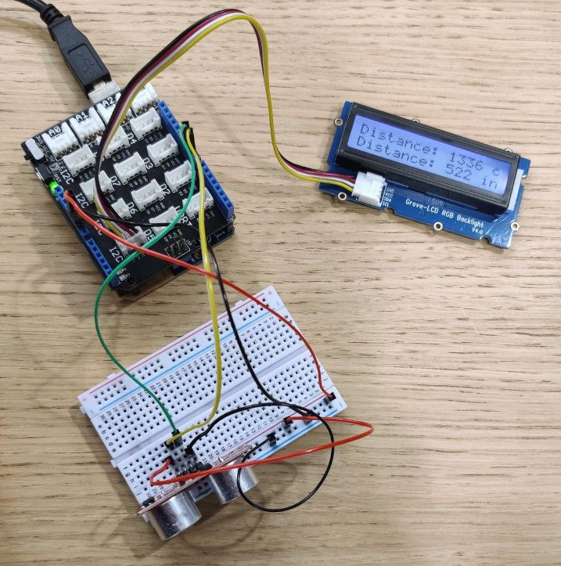
How does it work?
Arduino(distance sensors)
Firebase
«The place»

Slide 9
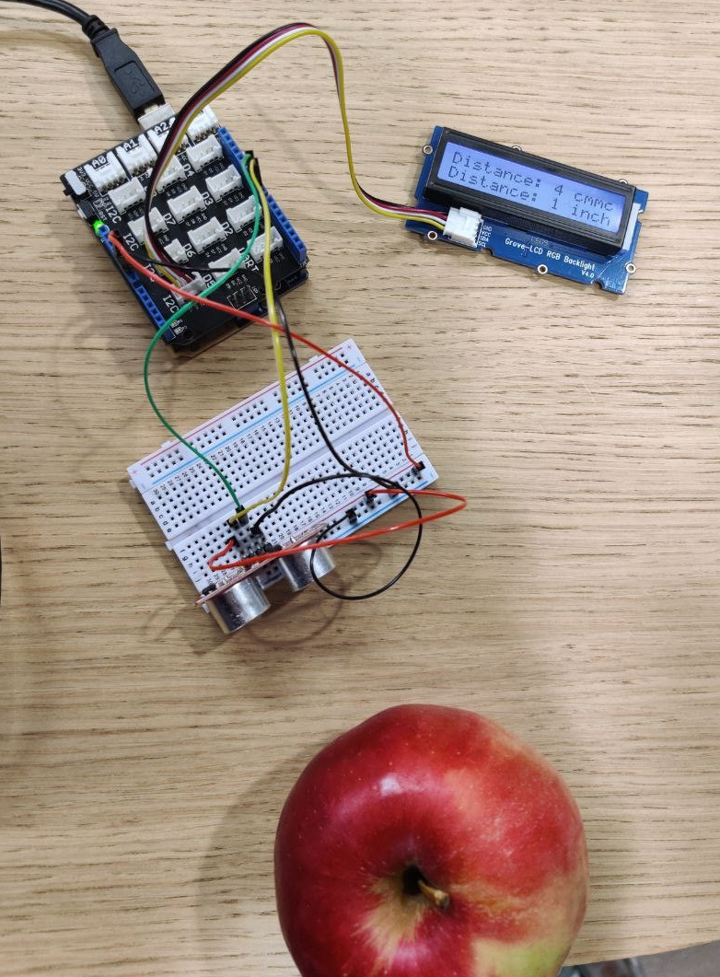
How does it work?
Arduino(distance sensors)
Firebase
«The place»

Slide 10
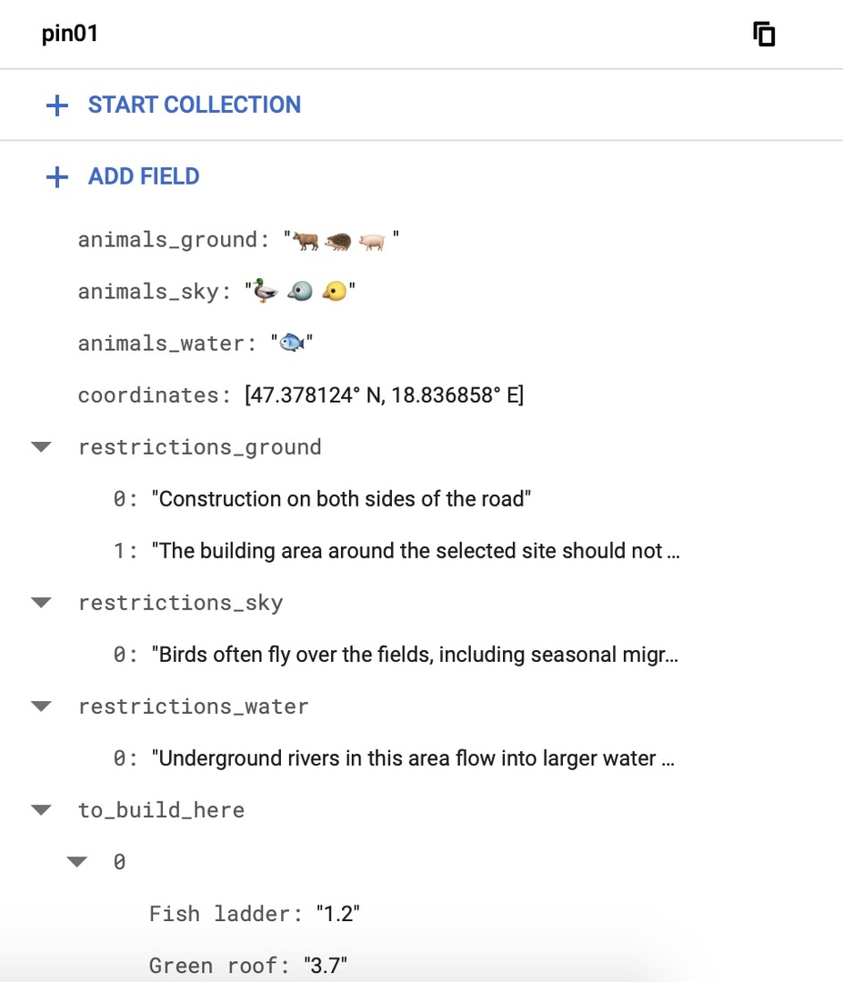
How does it work?
Arduino(distance sensors)
Firebase
«The place»

Slide 11
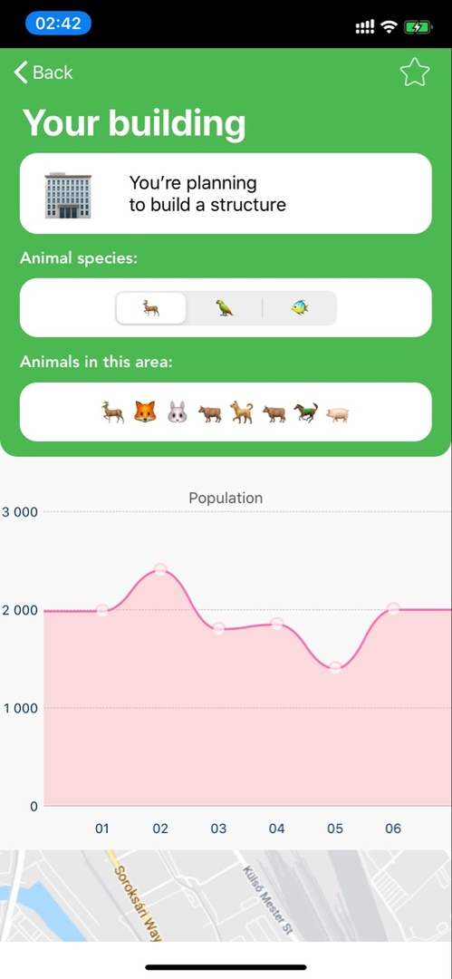
How does it work?
Arduino(distance sensors)
Firebase
«The place»

Slide 12
Who can use it?
An ordinary person
Big corporations & companies
Government

Slide 13
Plans for future: what to improve
Add more filters
Increase number of sensors
Collect seasonal animal migration data from our sensors

Slide 14





Our team

